Slide 1

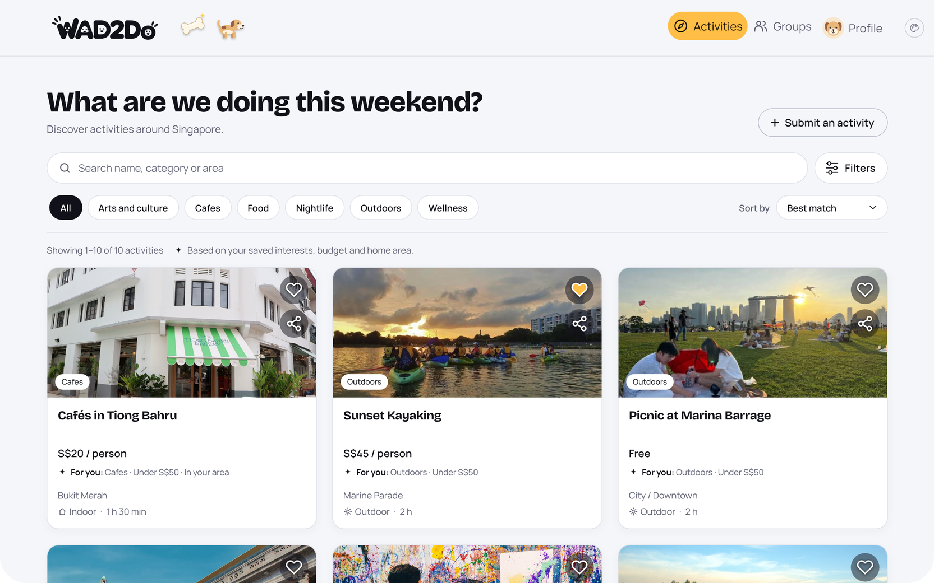
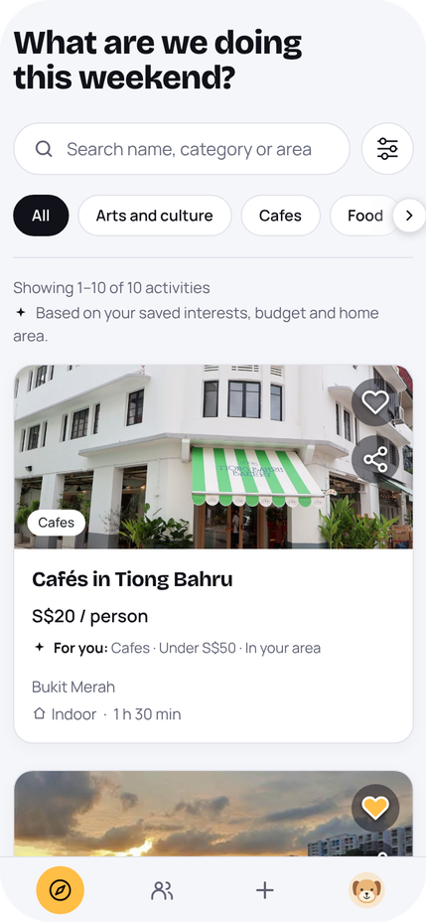
IS216 · G7 T3 · PROJECT PRESENTATION
WAD2Do · Activities
Turn free time
into
plans.
Discover things to do in Singapore, vote on them with your friends, find a time that works, and get an itinerary that fits.
PRESENTATION VIDEO
LIVE APP
Paste YouTube link
Paste app URL
Xin Hui · Meo Hui · Brendan · Wen Hsin · Emmanuel · Kin Yu
Notes:
TIME 0:00 to 0:20. Suggested speaker: Xin Hui (presentation lead).
Say: "Hi everyone, we're G7 Team 3 and this is WAD2Do, a web app that takes a group of friends from 'let's meet this weekend' to an agreed itinerary."
The screenshots are our real Activities page (desktop and phone), captured from the app running with sample activities.
TO DO BEFORE RECORDING: replace the two dashed boxes with the real YouTube link (unlisted or public) and the live Vercel URL. The briefing requires both on this first slide.
RECORDING CHECKLIST (briefing): maximum 12 minutes in total, at least 720p (ideally 1080p), uploaded to YouTube as Unlisted or Public. Record the demo in Chrome and drag the window narrow then wide to show it's responsive. Do a timed run-through first: the timings in these notes add up to exactly 12:00, so if you run long, trim the demo, not the slides that answer the rubric.
TRANSITION: "Let’s start with why we built it."

Slide 2
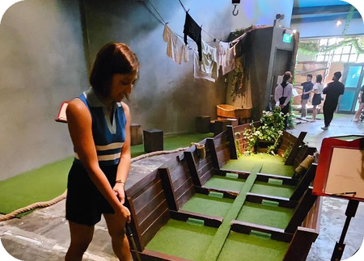
THE PROBLEM
Finding things to do is scattered.
Getting everyone to agree is harder.
01
02
03
Young working adults use multiple online platforms just to discover where to eat.
Affordability and convenient locations shape which recreation people choose.
In a group, everyone’s preferences and the travel involved decide the outing.
Leu et al. (2023), Appetite
URA (2026), More recreation closer to homes
Jin, Bansal & Axhausen (2025), Transportation Research Part A
Finding suitable activities and coordinating outings means juggling chat threads, polls and map apps. It is time-consuming.
SO WHAT
WAD2Do IS216 · G7 T3
Problem · Solution · Demo · Design · Tech · Wrap-up
02
Notes:
TIME 0:20 to 1:05. Suggested speaker: Xin Hui.
Say: Finding things to do isn't the problem. Planning with a group is. The research we cited backs three pieces of it: young adults hop across several platforms to discover places (Leu et al., 2023); affordability and convenient locations matter for recreation (URA, 2026); and in a group, everyone's preferences and the travel involved drive the decision (Jin et al., 2025).
Result: planning an outing becomes a chore spread over chat threads, polls and map apps. We don't have user surveys, so don't claim any numbers beyond these three sources.
TRANSITION: "So here’s what we built to fix that."

Slide 3
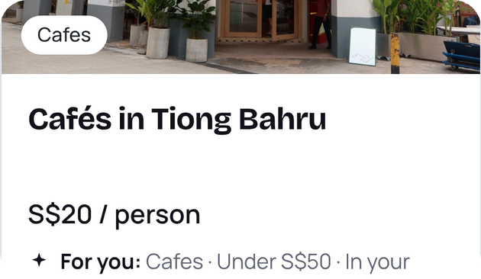
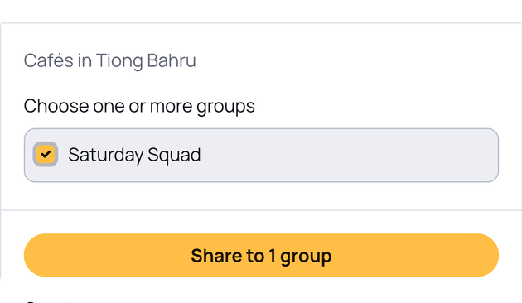
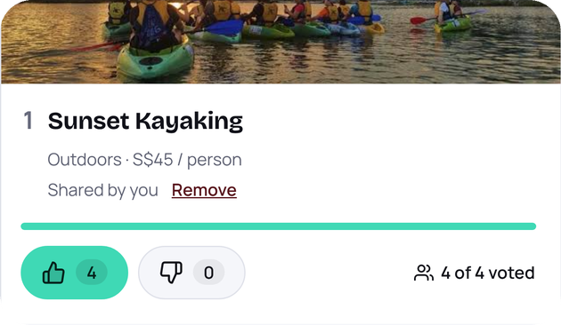
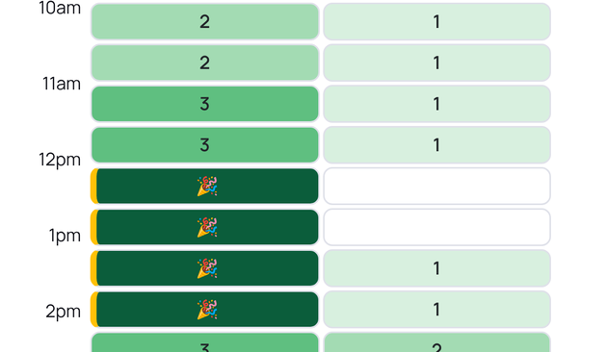
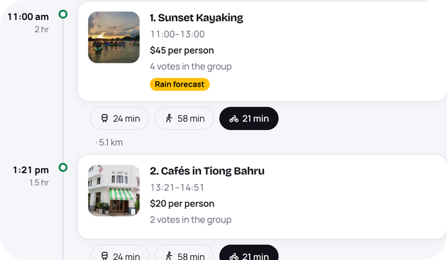
OUR SOLUTION
WHY IT HELPS
One app. Five steps.
One agreed plan.
One place instead of chat threads, polls and map apps
Everyone’s votes and free time shape the plan
Real limits respected: budget, hours, travel, rain
1 Discover
2 Share
3 Vote
4 Pick a time
Activities ranked by your interests, budget and home area.
Send the ones you like to a group you’re in.
5 Plan
Keen or not keen. One vote each, live for everyone.
Mark when you’re free. The heatmap shows when most can go.
One tap builds a timeline that fits time, budget, hours and travel.
Activities page
Share dialog
Group · Activities
Group · Availability
Group · Itinerary
WAD2Do IS216 · G7 T3
Problem · Solution · Demo · Design · Tech · Wrap-up
03
Notes:
TIME 1:05 to 1:45. Suggested speaker: Kin Yu.
Say: WAD2Do follows the order a group naturally plans in. You discover activities ranked for you, share the ones you like to a group, everyone votes keen or not keen, you mark when you're free on a heatmap, and then you press Plan and get an editable itinerary.
Each card shows the real part of our app for that step (close-ups captured from the app running with sample data). Votes and availability update live for every member (Supabase Realtime). Amber is the app's "do this" colour, which is why Plan is amber here.
TRANSITION: "Rather than tell you, let us show you, start to finish."

Slide 4
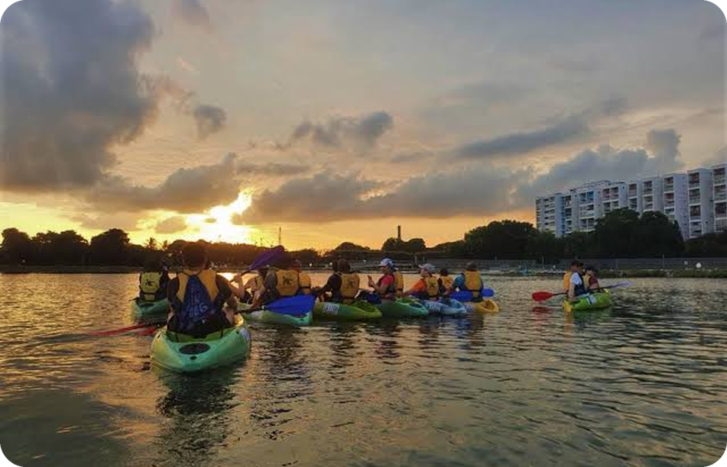
LIVE DEMO
1
Landing, sign up, log in
Emmanuel
Let’s plan an outing,
start to finish.
2
Onboarding and profile
Xin Hui
3
Browse, filter and share activities
Brendan
4
Create a group and vote
Kin Yu
5
Mark availability, press Plan
Meo Hui
6
Itinerary: weather, travel, edits
Wen Hsin
Resized live: phone to desktop
WAD2Do IS216 · G7 T3
Problem · Solution · Demo · Design · Tech · Wrap-up
04
Notes:
TIME 1:45 to 5:45 (about 4 minutes, roughly 40 seconds each). Switch to the browser.
This is a relay so every member presents, in the order a real group uses the app. Suggested owners come from the proposal: Emmanuel (landing, sign up, log in), Xin Hui (onboarding, profile), Brendan (activities), Kin Yu (groups, voting), Meo Hui (availability, Plan), Wen Hsin (itinerary).
Demo rules from the briefing: use Chrome, and drag the window narrower during the demo (phone width to wide desktop) to show the app is responsive. Have a dummy account and a group with a few votes ready so Plan runs without waiting. If one member is missing, merge their step into a neighbour.
TRANSITION: Switch back to slides. Emmanuel: "You’ve seen the flow, now let’s look at the design choices behind it."

Slide 5
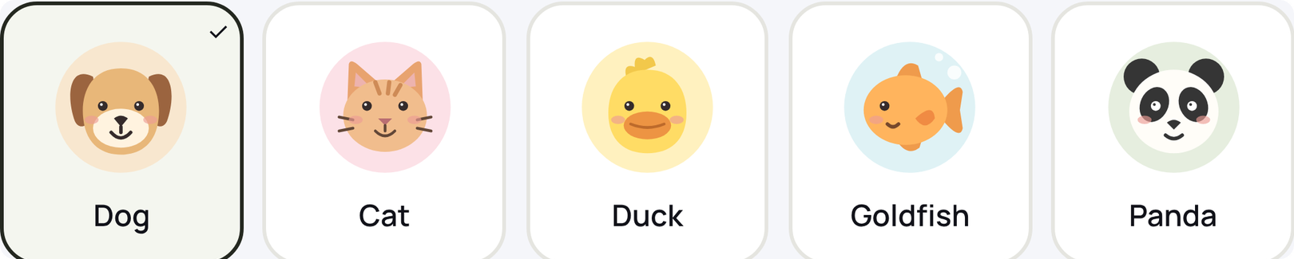
UI DESIGN · PERSONALITY
One navbar, six looks
Small touches that
make it feel like ours.
Light and dark follow your phone’s setting. Auto mode adds seasonal decorations around the holidays.
Brunch Club (light)
Pick a little face
Five animal avatars we drew in SVG. They show up in the navbar, groups and vote lists.
Supper Club (dark)
New Year
National Day
A friendly voice
Onboarding copy talks like a friend, with light Singapore phrasing.
Halloween
“What do you love doing?”
“No judgement.”
“3 picked. Nice!”
“You’re all set.”
Keen · Not keen
Christmas
WAD2Do IS216 · G7 T3
Problem · Solution · Demo · Design · Tech · Wrap-up
05
Notes:
TIME 5:45 to 6:25. Suggested speaker: Emmanuel (design/UI owner).
Say: Because this is a UI/UX course, we gave WAD2Do a personality, not just a layout.
- Avatars: every user picks one of five animal avatars (dog, cat, duck, goldfish, panda). We drew them as SVG inside our own AnimalAvatar component, so they stay sharp at any size and match the theme. They appear in the navbar, group member lists and the "Who voted" panel.
- Voice: our copy is casual and friendly: "What do you love doing?", "Per person, per hangout. No judgement.", "3 picked. Nice!", and "Keen / Not keen" for votes.
- Themes: one navbar, six looks. Light (Brunch Club) and dark (Supper Club) follow the device setting; Auto mode swaps in seasonal art for New Year, National Day, Halloween and Christmas. You can also pick a theme yourself from the palette button.
All screenshots are from our real app.
TRANSITION: "Personality is one half. The other half is making sure nobody gets lost." (hand to Xin Hui)

Slide 6
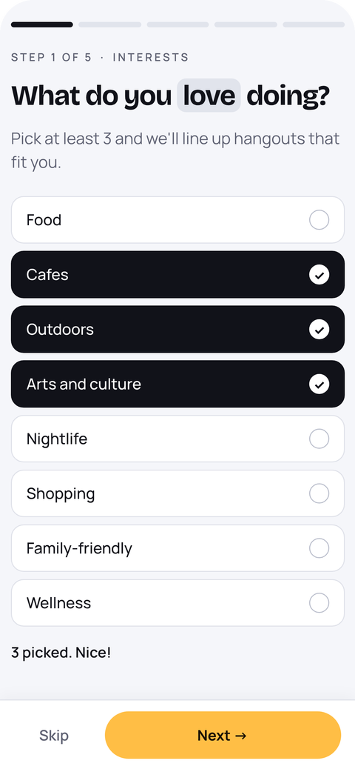
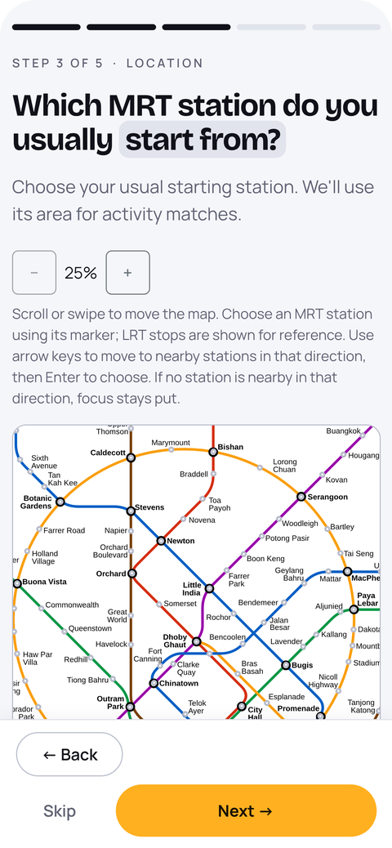
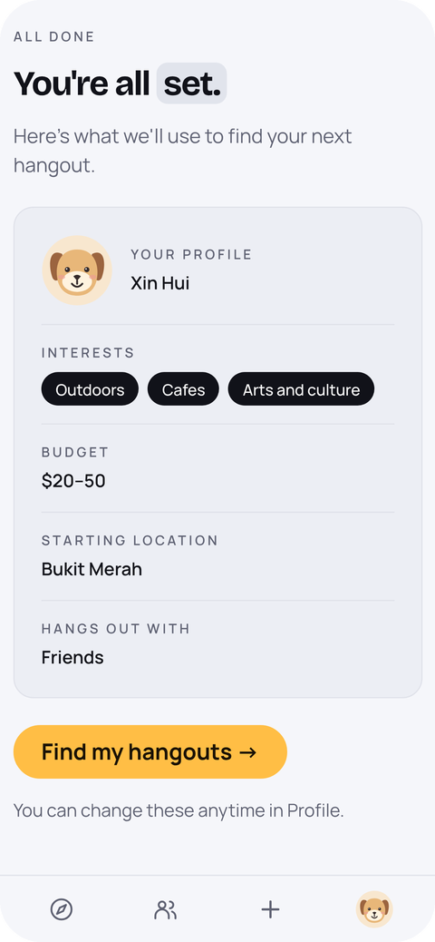
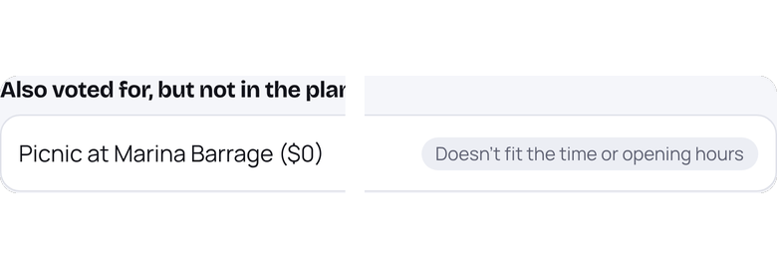

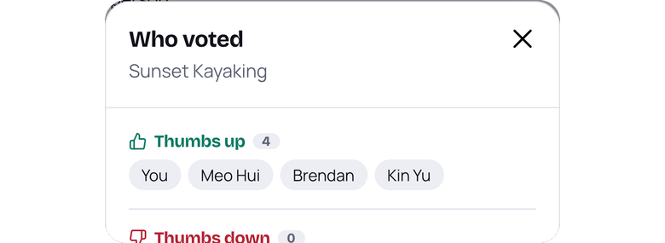
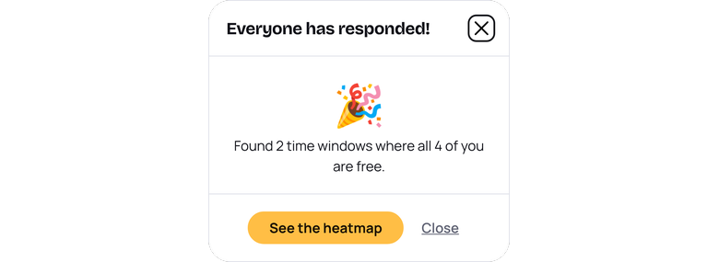
UX DESIGN · USABILITY
Designed so nobody gets lost.
Instant feedback
Show the why
Every action confirms itself. Short messages fade after 4 seconds.
Plan explains each choice, including what it left out.
See who voted
Celebrate progress
Tap a vote count to see exactly who is keen.
When everyone has marked their time, the app says so.
Guided onboarding: 5 short steps with a progress bar, Back and Skip on every step, and an MRT map instead of typing your area.
WAD2Do IS216 · G7 T3
Problem · Solution · Demo · Design · Tech · Wrap-up
06
Notes:
TIME 6:25 to 7:05. Suggested speaker: Xin Hui (onboarding and profile owner).
Say: We followed usability rules of thumb so a first-time user never feels lost.
- Guided onboarding (phones): 5 short steps with a progress bar and "Step 1 of 5", Back and Skip on every step, and a zoomable MRT map so you recognise your station instead of typing an address. It ends with a "You're all set" summary, and everything can be changed later in Profile.
- Feedback: actions confirm themselves ("Saved to your Profile."); routine messages fade after 4 seconds, and ones with a next step stay until closed.
- Show the why: the itinerary gives a reason for every stop, and lists voted activities it left out with the reason, e.g. "Doesn't fit the time or opening hours".
- Visibility: tap a vote count to see who voted which way.
- Celebrate progress: when all members have marked availability, a pop-up says how many time windows work for everyone.
Also worth mentioning if asked: every pop-up shares one accessible dialog component (Esc to close, focus kept inside), and keyboard focus rings are visible everywhere.
TRANSITION: "Here’s how we built that in code." (hand to Emmanuel)

Slide 7
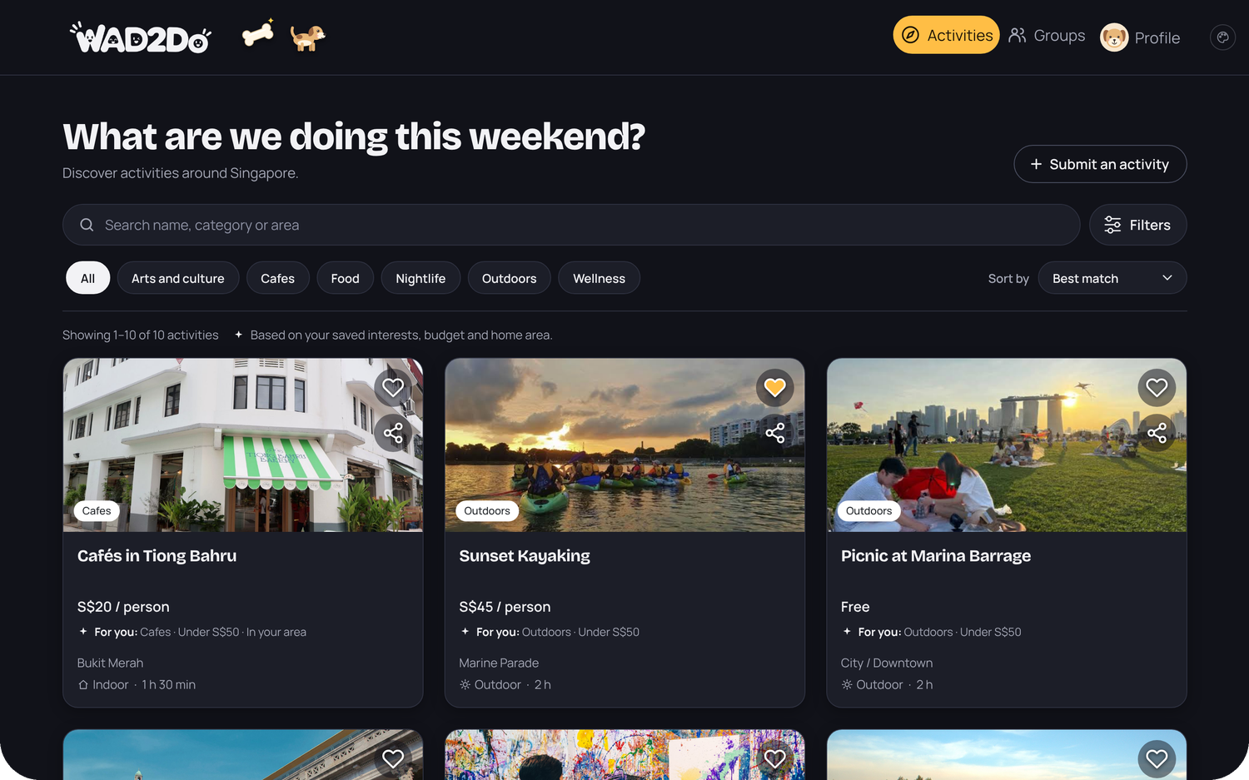
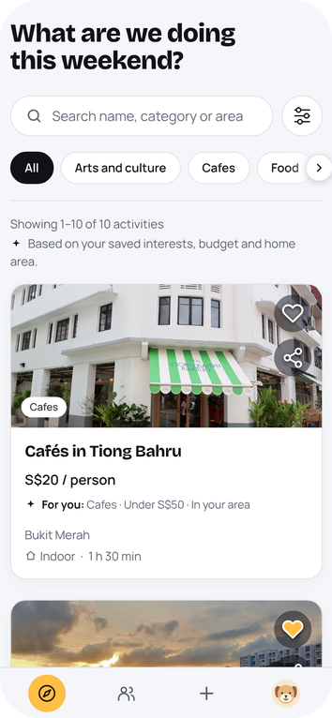
UNDER THE HOOD · FRONT END
Vue for the logic, Bootstrap for the layout,
one theme for the look.
Dynamic
VUE 3 + VUE ROUTER
Supper Club dark mode
v-for cards, v-model filters and computed vote ranking. Supabase Realtime keeps every member in sync.
Styled
BOOTSTRAP 5 + DESIGN TOKENS
Every colour, radius and shadow is a CSS variable, so light and dark modes come from one file.
Clean & responsive
PHONE TO DESKTOP
Bootstrap grid and breakpoints; on phones the navbar becomes a bottom tab bar. One amber action per screen keeps pages uncluttered.
OUR PALETTE
Aa
Bricolage Grotesque
and type
for headings, with Manrope for everything else
Page
Card
Ink
Action
Keen
Not keen
WAD2Do IS216 · G7 T3
Problem · Solution · Demo · Design · Tech · Wrap-up
07
Notes:
TIME 7:05 to 7:45. Suggested speaker: Emmanuel (design/UI owner).
Cover the three things the rubric asks about the front end:
1. JavaScript makes it dynamic: Vue's v-for, v-model and computed power the cards, filters and vote sorting, and Realtime pushes changes in.
2. CSS: Bootstrap 5 for layout, plus our own tokens so colours, corners and shadows come from one file. The browser on the right is the same Activities page in our dark "Supper Club" mode.
3. Responsive: the phone shows the same page at phone width, with the bottom tab bar. Markers test from iPhone 6 width up to Bootstrap's XL breakpoint in Chrome dev tools.
All these libraries are free and public (credits are on the team slide).
TRANSITION: "Behind the front end, all our data lives in one place." (hand to Meo Hui)

Slide 8
UNDER THE HOOD · DATA STORE
Our data store: Supabase PostgreSQL.
A cloud-hosted relational database. Auth, Realtime, Storage and Edge Functions come from the same backend.
Google Places
Supabase
Edge Functions
Google Places, OneMap
Vue app
OneMap routing
Vue 3 + Bootstrap 5
hosted on Vercel
Postgres
10 tables: activities, groups, votes…
STB Tourist Attractions
Auth
email sign-up and login
imported once
Realtime
live votes and availability
data.gov.sg weather
Storage
photos for submitted activities
called straight from the browser
WAD2Do IS216 · G7 T3
Problem · Solution · Demo · Design · Tech · Wrap-up
08
Notes:
TIME 7:45 to 8:20. Suggested speaker: Meo Hui (database owner).
State the data store clearly, as the briefing asks: Supabase Postgres, 10 tables (profiles, activities, groups, group_members, group_activities, votes, availability, itineraries, favourites, submissions). Also: Supabase Auth for login, Realtime for live votes and availability, Storage for submitted activity photos.
Edge Functions (google-place-search, google-place-details, onemap-route) sit between the browser and Google/OneMap so keys and tokens never reach the browser. The weather call goes straight from the browser because that API is open. The STB dataset was imported into the activities table once.
TRANSITION: "Supabase talks to four outside data sources." (hand to Brendan)

Slide 9
UNDER THE HOOD · EXTERNAL APIS
Four outside data sources,
each used for a reason.
EDGE FUNCTION
EDGE FUNCTION
DATASET IMPORT
BROWSER FETCH
Google Places
OneMap routing
STB Tourist Attractions
data.gov.sg weather
WHAT FOR
WHAT FOR
WHAT FOR
WHAT FOR
Search and live details: rating and opening hours.
Real travel time between two stops.
The seed list of Singapore attractions.
A rain check for the plan’s date.
HOW
HOW
HOW
HOW
google-place-search and google-place-details.
onemap-route keeps the token on the server.
data.gov.sg dataset imported into our activities table.
fetch() to the 4-day outlook endpoint.
WHAT WE HANDLED
WHAT WE HANDLED
WHAT WE HANDLED
WHAT WE HANDLED
Terms allow storing only the place_id, so details are fetched live.
Returns MRT, bus, transit, walk and cycle options. Stops that overrun are skipped.
It has no prices or categories, so we curate those ourselves.
Showers mean indoor swaps. Later dates say “Forecast not available yet”.
WAD2Do IS216 · G7 T3
Problem · Solution · Demo · Design · Tech · Wrap-up
09
Notes:
TIME 8:20 to 9:00. Suggested speaker: Brendan (data and API owner).
Briefing asks you to name each external API and give brief integration details. One line each:
- Google Places: via Edge Functions, we store only the place_id (Google's terms) and fetch rating and hours live.
- OneMap: via the onemap-route Edge Function so the token is private; returns five travel options per leg.
- STB Tourist Attractions: imported once from data.gov.sg; no prices or categories, so we filled those ourselves.
- data.gov.sg 4-day weather: fetched from the browser for the plan's date; showers trigger indoor swaps; beyond four days the timeline says "Forecast not available yet".
TRANSITION: "Those sources come together when you press Plan." (hand to Meo Hui)

Slide 10
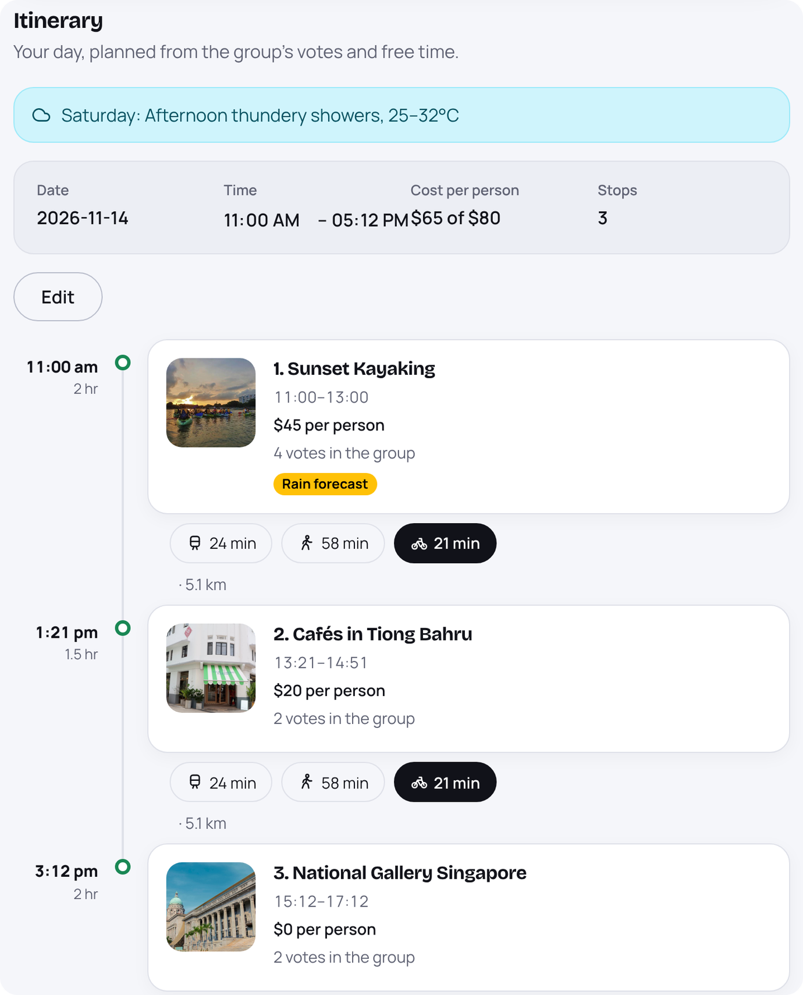
OUR OWN LOGIC
How Plan builds
an itinerary
1
Start with the group’s voted activities, highest net votes first.
2
Add a stop only if it fits the chosen time slot and the remaining budget.
3
Ask OneMap how long the trip from the previous stop takes.
4
Check the place is open for the whole visit.
5
Save the plan. If showers are forecast, outdoor stops get indoor swaps.
BEST MATCH ON THE ACTIVITIES PAGE
Interest +4
Budget +2
Your area +1
WAD2Do IS216 · G7 T3
Problem · Solution · Demo · Design · Tech · Wrap-up
10
Notes:
TIME 9:00 to 9:40. Suggested speaker: Meo Hui (Plan function).
This is the part that goes beyond the minimum, and it is a function we wrote ourselves, not a library. The planner sorts the group's voted activities by net votes, then walks down the list adding each one only if: it fits the time left in the chosen slot, it fits the remaining budget per person, the OneMap travel time from the last stop still fits, and the place is open for the full visit. Each stop stores a reason ("N votes in the group"). If showers are forecast for that date, outdoor stops get an indoor alternative from activities the group already voted for.
The screenshot on the right is our real Itinerary tab, output by Plan. It was captured from the app running with sample activities and votes, and a sample showers forecast, so point out the weather banner, the "Rain forecast" badge, the travel options between stops and the "4 votes in the group" reasons.
Bottom chips: the Activities page "Best match" score is interest match +4, under budget +2, same area +1 (from activityRanking.js).
TRANSITION: "Plan is one of several things we built beyond the minimum." (hand to Kin Yu)

Slide 11
BEYOND THE MINIMUM
Extras we built because
a real group would need them.
Live updates
Private API keys
Our own planner
Votes and availability appear for every member instantly, no refresh.
Google Places and OneMap are called from the server, never the browser.
Builds the itinerary from votes, time, budget, hours and travel.
Supabase Realtime
Supabase Edge Functions
Written by us in JavaScript
Map station picker
Community activities
Easy joining
Pick your starting MRT station on a zoomable map instead of typing an area.
Anyone can submit a place with a photo; admins approve or reject it.
Join a group by invite link, short code or QR code.
Vue component + SVG map
Supabase Storage
qrcode library
WAD2Do IS216 · G7 T3
Problem · Solution · Demo · Design · Tech · Wrap-up
11
Notes:
TIME 9:40 to 10:15. Suggested speaker: Kin Yu.
The briefing asks you to mention technologies beyond the minimum. Go quickly, one sentence each:
- Realtime: votes and availability update live for everyone (Supabase Realtime channels on the votes, group_activities and availability tables).
- Edge Functions: Google Places and OneMap keys stay on the server.
- Our planner: the Plan algorithm on the previous slide is our own code.
- Map station picker: onboarding and Profile let you pick your home MRT station on a zoomable, keyboard-friendly map (MrtStationPicker).
- Community submissions: photo upload to Supabase Storage, admin review with approve/reject, approved ones get a "Community" badge.
- Joining: invite link, 6-character code or QR code (qrcode library).
TRANSITION: "So, did we meet everything the project asked for?" (hand to Wen Hsin)

Slide 12
PROJECT REQUIREMENTS
Every requirement, met and tested.
200+
REQUIREMENT
HOW WE MET IT
SLIDE
Dynamic & interactive
Vue 3 + Vue Router, Supabase Realtime
07
end-to-end test cases
✓
17 Playwright spec files
✓
Styled & responsive
Bootstrap 5, design tokens, phone to desktop
05–07
Data store
Supabase PostgreSQL, 10 tables
08
50+
✓
pull requests merged
✓
External APIs
Google Places, OneMap, 2 × data.gov.sg
09
180+ commits, 22 branches
✓
End-to-end tests
Playwright, every core flow covered
→
12
✓
GitHub collaboration
Feature branches merged by pull request
→
unit & database test files
Deployment
Vercel, live link on the first slide
01
ranking, hours, places, groups
✓
WAD2Do IS216 · G7 T3
Problem · Solution · Demo · Design · Tech · Wrap-up
12
Notes:
TIME 10:15 to 10:55. Suggested speaker: Wen Hsin (testing owner).
Say: To wrap up the technical side, here's how we met every project requirement. Run down the checklist quickly; each row points to the slide where we showed it.
Testing and GitHub, which no other slide covers:
- 200+ Playwright end-to-end tests across 17 spec files, covering every core flow (sign up, onboarding, browsing, sharing, voting, availability, itinerary). Every element a test touches has a data-testid, so the tests are stable. Run them with pnpm run test:e2e (in the README).
- Each feature was built on its own branch and merged through a pull request: 50+ PRs, 180+ commits, 22 branches.
- Google and OneMap keys stay private in Edge Functions.
Numbers counted from the repo on Nov 3 (about 237 tests, 52 merged PRs, 181 commits). Re-count before you submit. Only say "deployed on Vercel" once it's actually live.
TRANSITION: "And the six people who built it." (hand to Xin Hui)

Slide 13
THE TEAM
Six people, six areas,
one product.
Xin Hui
Meo Hui
Brendan
DEPLOYMENT · PRESENTATION LEAD
DATABASE OWNER
DATA AND API OWNER
Onboarding · Profile
Group availability heatmap · Plan function
Activities page · Activity detail
Wen Hsin
Emmanuel
Kin Yu
TESTING OWNER
DESIGN AND UI OWNER
GITHUB · DEADLINES
Group itinerary: timeline, weather swaps, edits
Landing · Sign up · Log in · Submit · Admin review · Navbar
Groups · Group activities tab with live voting
BUILT WITH FREE PUBLIC LIBRARIES Vue 3 · Vue Router · Vite · Bootstrap 5 · Supabase JS · qrcode · Playwright · Bricolage Grotesque and Manrope (Google Fonts)
WAD2Do IS216 · G7 T3
Problem · Solution · Demo · Design · Tech · Wrap-up
13
Notes:
TIME 10:55 to 11:25. Suggested speaker: Xin Hui.
Quick roll call so every member is named with what they built. Roles and pages are taken straight from the project proposal and progress pitch.
The briefing requires free libraries to be identified in the presentation (and in code comments), so the strip along the bottom does that. Add anything else you installed. If you used AI tools (the course allows it for lower-order tasks only), state which parts in README.txt as the briefing requires. The photos in the app are curated activity images: make sure you can say where they came from if asked.
TRANSITION: "That’s WAD2Do."

Slide 14


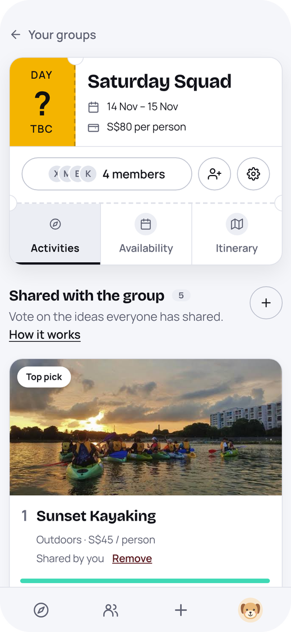
Thank you.
Questions?
Discover · Share · Vote · Pick a time · Plan
PRESENTATION VIDEO
LIVE APP
Paste YouTube link
Paste app URL
WAD2Do IS216 · G7 T3
Problem · Solution · Demo · Design · Tech · Wrap-up
14
Notes:
TIME 11:25 to 12:00. Suggested speaker: Everyone, then Xin Hui closes.
Say: "Thanks for watching. WAD2Do takes a group from 'let's meet this weekend' to an agreed itinerary in one app." For the live session you then have 3 minutes of Q&A. Keep this slide up during Q&A.
Same two link boxes as slide 1: replace with the real YouTube and app URLs.
Likely questions to rehearse: how Plan handles a clash of opening hours or budget; why only place_id is stored for Google Places; how Realtime works; what happens beyond the 4-day forecast; how you tested; who did what.

Slide 15
APPENDIX
References and data sources
RESEARCH
Jin, Z., Bansal, P., & Axhausen, K. W. (2025). A novel approach to study the role of social networks in planning joint leisure activities. Transportation Research Part A: Policy and Practice, 192, 104371. https://doi.org/10.1016/j.tra.2024.104371
Leu, J., Rebello, S. A., Sargent, G. M., Kelly, M., & Banwell, C. (2023). The Singaporean foodscape: Convenience, choice, entertainment, and sociality for young workers. Appetite, 189, 106992. https://doi.org/10.1016/j.appet.2023.106992
Urban Redevelopment Authority. (2026, June 24). More recreation closer to homes. https://www.ura.gov.sg/land-planning/long-term-plan/space-for-our-dreams-exhibition/play/more-recreation/
DATA AND APIS
Tourist Attractions dataset
Singapore Tourism Board via data.gov.sg
data.gov.sg/datasets/d_0f2f47515425404e6c9d2a040dd87354
4-day weather outlook API
data.gov.sg (NEA)
api-open.data.gov.sg/v2/real-time/api/four-day-outlook
Places API
Google Maps Platform
developers.google.com/maps/documentation/places
Routing API
OneMap (Singapore Land Authority)
onemap.gov.sg/apidocs/routing
WAD2Do IS216 · G7 T3
15
Notes:
Appendix, not presented. It's here so markers reading the PDF can see full references for the problem slide and every data source. Keep the "Thank you / Questions?" slide on screen during Q&A.

